Slide 1
CAPSTONE PROJECT Chicago taxi trips – tip prediction
- Alisha Antony

Slide 2
Contents
Introduction
Problem Statement
Dataset
Data Limitations
Data Wrangling
Steps followed to predict tips
Conclusion
Recommendation

Slide 3
Introduction
This dataset includes taxi trips for 2016, reported to the City of Chicago in its role as a regulatory agency.
Taxicabs in Chicago, Illinois, are operated by private companies and licensed by the city.
To protect privacy but allow for aggregate analyses, the Taxi ID is consistent for any given taxi medallion number but does not show the number.
Using this data, an attempt to predict whether a driver will get a tip or not.

Slide 4
Problem Statement
Cab drivers aren't paid on a commission though they pay so many taxes and fees.
Their pay is all of their fare+tips minus the lease fee, gas, and all of the fees.
Taxi drivers should be tipped 10 percent to 20 percent of the fare, which you should be able to leave when you pay with a credit card. However, a cash tip is always preferred.
Standard tip for a cab driver is 15%.

Slide 5
Dataset
The dataset is taken from Kaggle. It includes taxi trips for 2016, reported to the City of Chicago in its role as a regulatory agency. It has more than 10 million observations for each month in the year 2016.
It has 12 different .csv files. Each csv file for a month. The columns (variables) of all the 12 datasets are the same.
Columns are: taxi_id, trip_start_timestamp, trip_end_timestamp, trip_seconds, trip_miles, pickup_census_tract, dropoff_census_tract, pickup_community_area, dropoff_community_area, fare, tips, tolls, extras, trip_total, payment_type, company, pickup_latitude, pickup_longitude, dropoff_latitude, dropoff_longitude.

Slide 6
Data Limitations
The dataset was comprehensive with few missing values. Columns which were not needed for the analysis were removed.
The dataset imported to Python was stored in the dataframe where NAN values were checked and removed.
In the taxi trip data, few observations had 0 pickup_latitude, 0 pickup_longitude, 0 dropoff_latitude, 0 dropoff_longitude. Hence, these records were removed as it was of no use having these observations.

Slide 7
Data Wrangling
The dataset was comprehensive with few missing values. It required some cleanup and reformatting. The steps taken are described below:
Columns which were not needed for the analysis were removed for example pickup census tract as this column did not have any values included, due to security purposes.
The dataset imported to Python was stored in the dataframe where NAN values were checked and removed.
These transformations were helpful to conduct preliminary exploration and data visualization.
In the taxi trip data, few observations had 0 pickup_latitude, 0 pickup_longitude, 0 dropoff_latitude, 0 dropoff_longitude. Hence, these records were removed as it was of no use having these observations.
All the 12 datasets were combined together to have a collaborative analysis.
The numerical variables and the categorical variables were separated to carry out better results.
After considering all these factors from the data and cleaning up the data, now the data is ready for further analysis.

Slide 8
Steps followed to complete the tip prediction
The below steps were followed to complete the tip prediction:
Importing important packages
Loading the data
Preprocessing and Exploratory Data Analysis (EDA)
Splitting taxi trip data into train and test
Feature selection and modelling
Modelling and plotting the graphs
Conclusions
Recommendations

Slide 9
IMPORTING IMPORTANT PACKAGES
Functions, modules and packages are all constructs in Python that promote code modularization.
Module contents are made available to the caller with the import statement. The import statement takes many different forms, shown below:
import <module_name>
from <module_name> import <name(s)>
from <module_name> import <name> as <alt_name>
import <module_name> as <alt_name>

Slide 10
LOADING THE DATA
The datasets that we have are all of .csv types. CSV (comma-separated value) files are a common file format for transferring and storing data.
Steps to Load CSV files to Python Pandas:
Understanding file extensions and file types – what do the letters CSV actually mean? What’s the difference between a .csv file and a .txt file?
Understanding how data is represented inside CSV files – if you open a CSV file, what does the data actually look like?
Understanding the Python path and how to reference a file – what is the absolute and relative path to the file you are loading? What directory are you working in?
CSV data formats and errors – common errors with the function.

Slide 11
PREPROCESSING AND EXPLORATORY DATA ANALYSIS (EDA)
The following steps were followed for preprocessing:
Viewed the data to understand its structure and fields
Listed more information about the given data like the data types, column names, number of rows etc.
Took the statistical summary of the data using describe().
Handled the missing values in the dataset
Combined all the 12 different datasets (.csv files) for a better combined analysis
Separated the categorical and the numerical variables
Checked the top absolute correlations

Slide 12
The Exploratory Data Analyses are as follows:
Identified the target variable
Checked the skewness of the target variable
Calculated the summary statistic of the target variable
Checked the correlation between the variables
Computed the Pearson’s correlation
Scatter plots and regression plots were checked for the strongly correlated variables with the target variable.
Outlier Detection

Slide 13
Identifying the target variable
As our goal is to predict the tips of each taxi ride, it was very simple to identify the target variable. Here, our target variable is ‘tips’.
We decided to choose tips over fare as it is a bit more challenging than finding fare. We cannot blindly come to a conclusion on which variable is actually affecting the tips. It clearly depends on the customer whether to provide a tip or no. It also depends on the driver’s behaviour, customer’s mood etc.
However, from the data that we have, we have managed to find the variables that are strongly correlated with tips to help find the solution.

Slide 14
Checked the skewness of the target variable
The formula used to find skewness is:
Skew = 3 * (Mean – Median) / Standard Deviation.
If skewness is less than -1 or greater than 1, the distribution is highly skewed. If skewness is between -1 and -0.5 or between 0.5 and 1, the distribution is moderately skewed. If skewness is between -0.5 and 0.5, the distribution is approximately symmetric.
The skewness of target is 7.123919535177937.
Hence, we can say that the distribution is highly skewed.

Slide 15
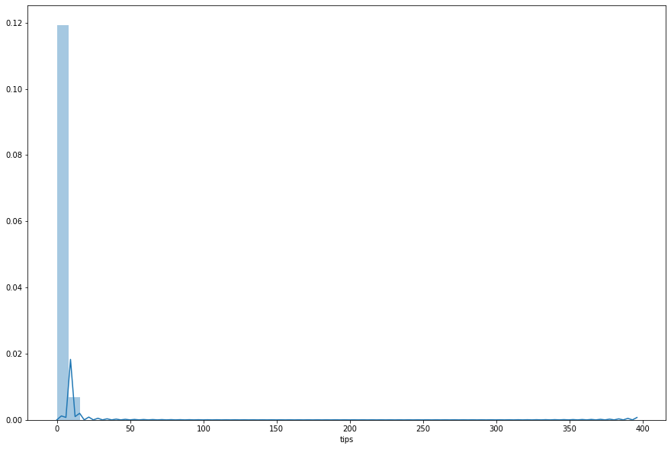
Skewness of ‘tips’

Slide 16
Calculated the summary statistic of the target variable
count 7.564042e+06
mean 1.536023e+00
std 2.636438e+00
min 0.000000e+00
25% 0.000000e+00
50% 0.000000e+00
75% 2.000000e+00
max 3.960000e+02

Slide 17
Checked the correlation between the variables
Correlation is a statistical measure that indicates the extent to which two or more variables fluctuate together. A positive correlation indicates the extent to which those variables increase or decrease in parallel; a negative correlation indicates the extent to which one variable increases as the other decreases. A correlation coefficient is a statistical measure of the degree to which changes to the value of one variable predict change to the value of another.

Slide 18
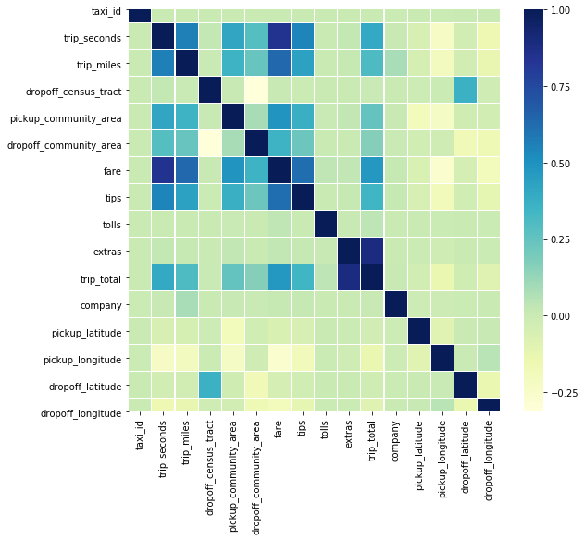
Correlation Matrix

Slide 19
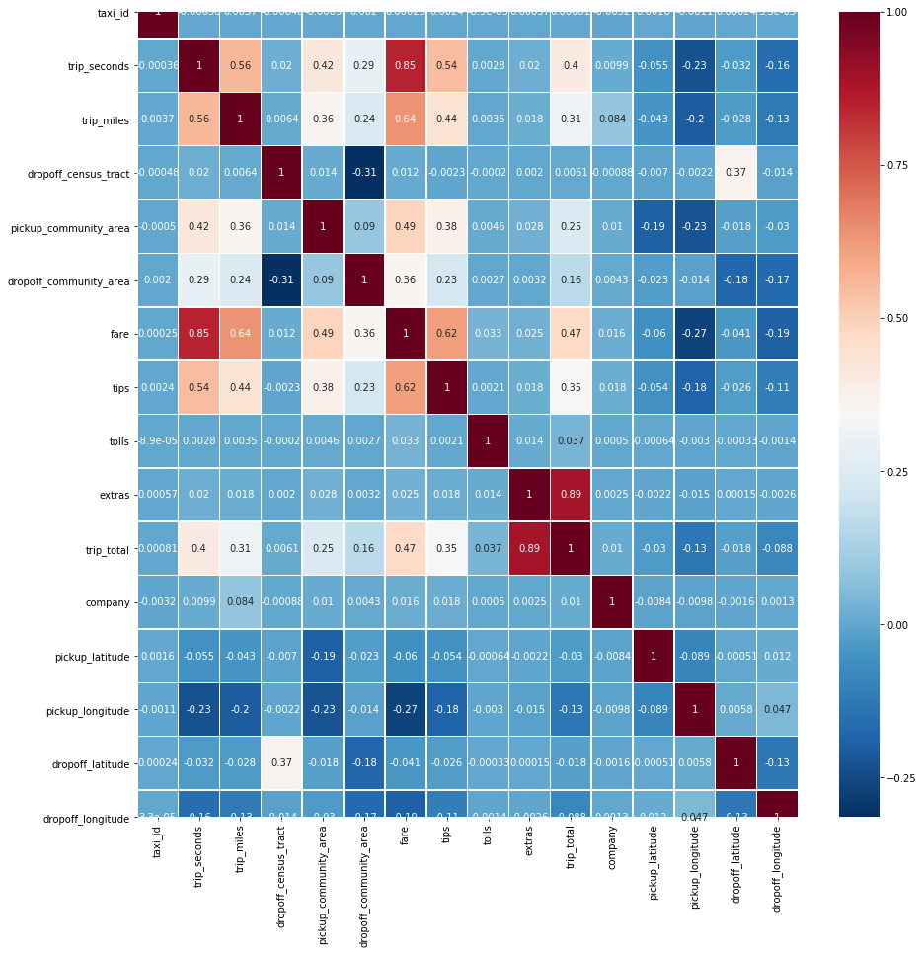
Computed the Pearson’s correlation

Slide 20
From the Pearson’s correlation heatmap, we can understand that there are few fields that are correlated with 'tips'. The strongest correlation of tips is with fare. As the fare increases, the tips also tend to increase. Then comes the trip_seconds and trip_miles. As the time and distance of the trip increases, the tips given also increases. We can also see that the pickup and dropoff latitudes and longitudes have a negative correlation with tips. This means that as the latitudes and longitude increases, the tips tend to have a decrease.

Slide 21
Scatter plots and regression plots were checked for the strongly correlated variables with the target variable.
The strongly correlated variables with the target variable (tips) are:
'fare’
‘trip_seconds’
‘trip_miles’

Slide 22
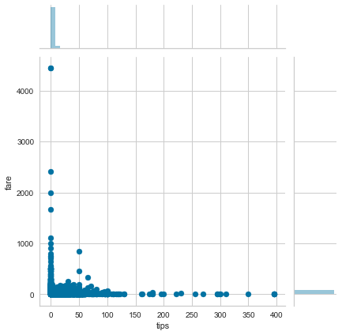
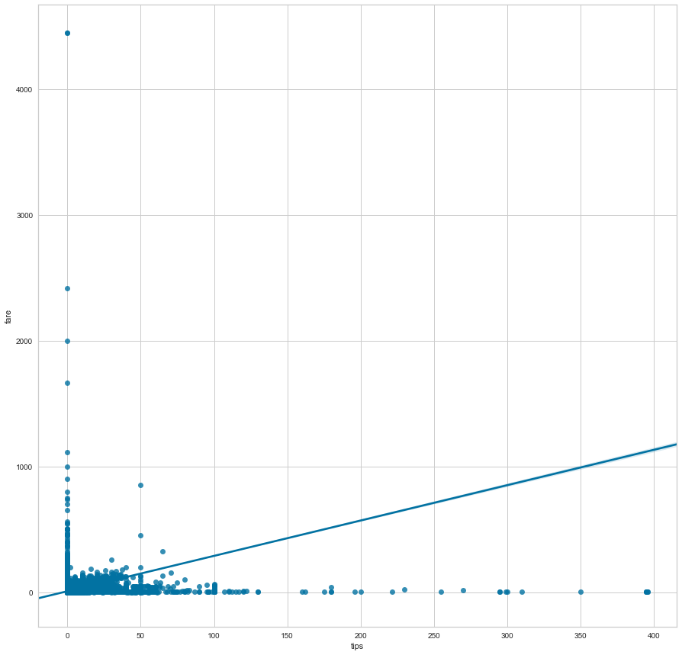
Scatter and Regression plot for ‘tips’ and ‘fare’
As plotted in the graphs above, we do see that a change in fare definitely has an impact on the tips as well. As the fare increases, the tips value also increases and vice-versa.

Slide 23
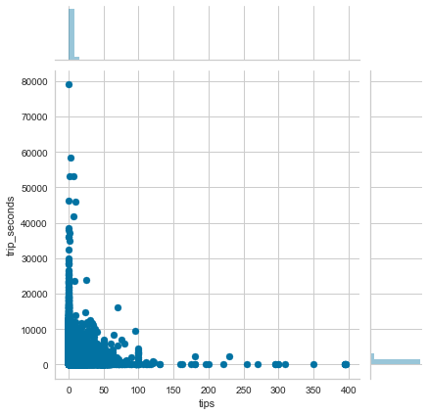
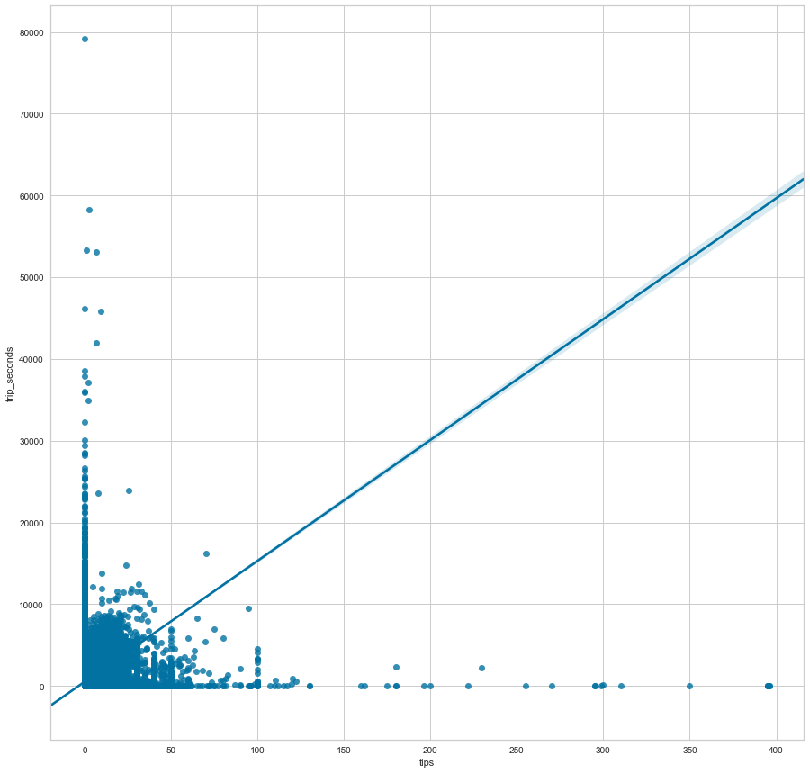
Scatter and Regression plot for ‘tips’ and ‘trip_seconds’
As plotted in the graphs above, we can see that there is a change in tips as and when there is a change in the time of the trip. As the trip_seconds increases, the tips value also increases and vice-versa.

Slide 24
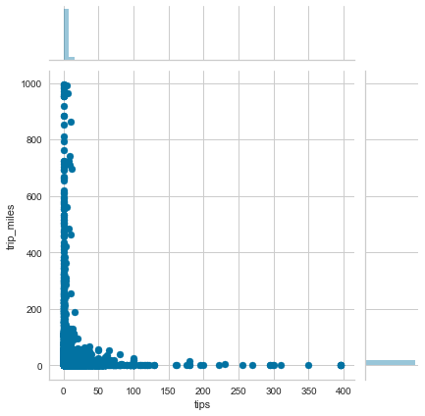
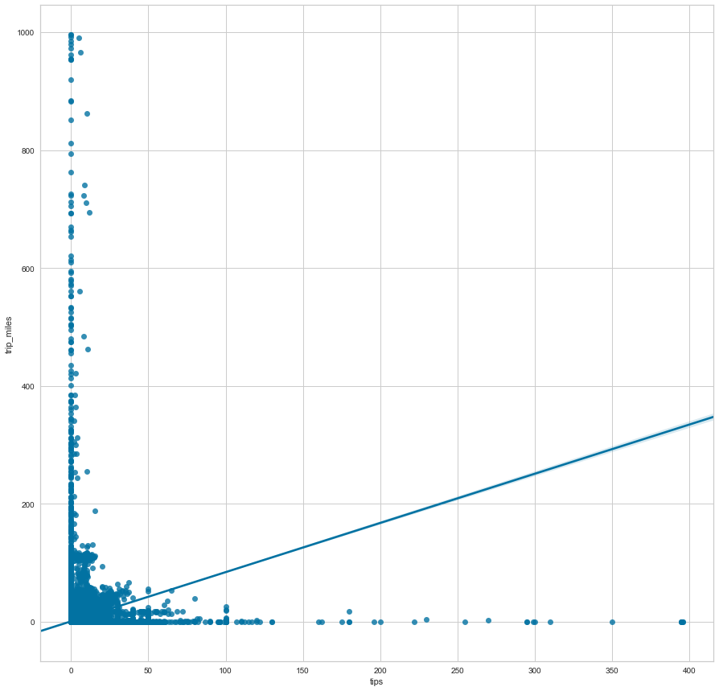
Scatter and Regression plot for ‘tips’ and ‘trip_miles’
As shown in the graphs above, we can see that the tips value has an impact when there is a change in the distance of the trip. As the trip_miles increases, the tips value also increases and vice-versa.

Slide 25
Listing the linearly correlated columns with Target
tips 1.000000
fare 0.618485
trip_seconds 0.544883
trip_miles 0.439544
pickup_community_area 0.376597
trip_total 0.347734
dropoff_community_area 0.225430
extras 0.018396
company 0.017947
taxi_id 0.002392
tolls 0.002108
dropoff_census_tract -0.002348
dropoff_latitude -0.026455
pickup_latitude -0.054043
dropoff_longitude -0.112690
pickup_longitude -0.181162

Slide 26
Outlier Detection
An outlier is an observation that appears to deviate markedly from other observations in the sample. Identification of potential outliers is important for the following reasons:
An outlier may indicate bad data. For example, the data may have been coded incorrectly or an experiment may not have been run correctly. If it can be determined that an outlying point is in fact erroneous, then the outlying value should be deleted from the analysis (or corrected if possible).
In some cases, it may not be possible to determine if an outlying point is bad data. Outliers may be due to random variation or may indicate something scientifically interesting. In any event, we typically do not want to simply delete the outlying observation. However, if the data contains significant outliers, we may need to consider the use of robust statistical techniques

Slide 27
Checked Outlier Detection Of One Variable - (just to see the process,we worked with one variable and detected outliers)
Variable selected: fare
We used a log transform to the variable ‘fare’ to transform the data as our target variable is highly skewed.

Slide 28
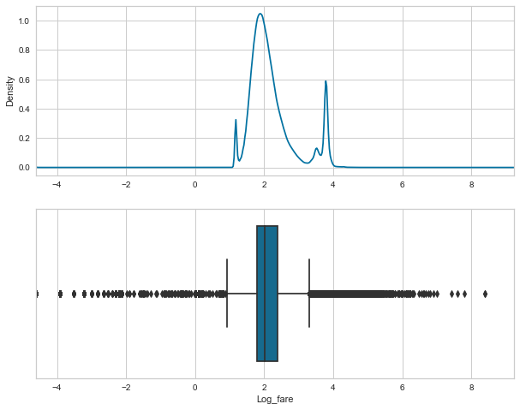
We loaded the data into Python, removed rows that had missing data. We then used a log transform to transform the data as our target variable is highly skewed.
The log transformation can be used to make highly skewed distributions less skewed. This can be valuable both for making patterns in the data more interpretable and for helping to meet the assumptions of inferential statistics.

Slide 29
SPLITTING TAXI TRIP DATA INTO TRAIN AND TEST
Separating data into training and testing sets is an important part of evaluating data mining models. Typically, when you separate a data set into a training set and testing set, most of the data (80%) is used for training, and a smaller portion of the data (20%) is used for testing.

Slide 30
FEATURE SELECTION AND MODELLING
Feature selection is a process where you automatically select those features in your data that contribute most to the prediction variable or output in which you are interested. Having irrelevant features in your data can decrease the accuracy of many models, especially linear algorithms like linear and logistic regression.

Slide 31
LINEAR REGRESSION
We tried a linear regression with multiple combinations of data to find out which are the variables contributing to the success of receiving tips. The combinations are as follows:
Linear regression with all the numerical variables
Linear regression with all the negatively correlated variables
Linear regression with all the variables related to the cost of the trip
Linear regression with the distance and duration variables of the trip
Linear regression with the variables related to community area
Linear regression with the variables related latitudes and longitudes
Linear regression with the positively correlated variables

Slide 32
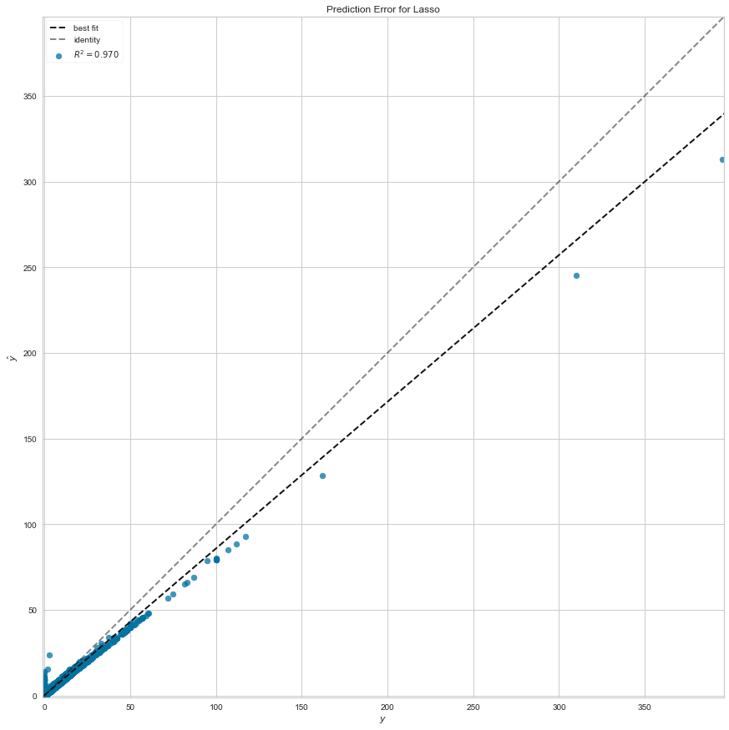
Linear regression with all the numerical variables
Actual vs Predicted value table:
Prediction-error graph:
Row count | Actual | Predicted
0 | 2 | 2.00E+00
1 | 0 | -6.17E-12
2 | 9.2 | 9.20E+00
3 | 0 | -6.20E-12
4 | 0 | -6.20E-12
... | ... | ...
1512804 | 1.5 | 1.50E+00
1512805 | 0 | -6.18E-12
1512806 | 14.6 | 1.46E+01
1512807 | 2 | 2.00E+00
1512808 | 3 | 3.00E+00
1512809 rows × 2 columns

Slide 33
By looking into the predicted values for the linear regression with the numeric variables, we can see that the predictions are very closely successful for the actual values that are greater than 0. However, we do get incorrect (negative) predictions for the actual values that are equal to 0.

Slide 34
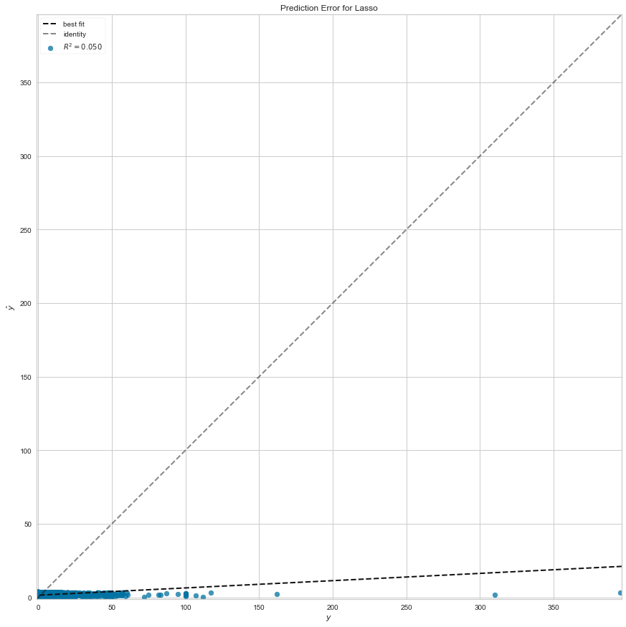
Linear regression with all the negatively correlated variables
Actual vs Predicted value table:
Prediction-error graph:
Row count | Actual | Predicted
0 | 2 | 0.787124
1 | 0 | 0.859128
2 | 9.2 | 1.578619
3 | 0 | 1.850171
4 | 0 | 1.221528
... | ... | ...
1512804 | 1.5 | 1.282387
1512805 | 0 | 1.262293
1512806 | 14.6 | 1.872023
1512807 | 2 | 0.591227
1512808 | 3 | 1.200364
1512809 rows × 2 columns

Slide 35
By looking into the predicted values for the linear regression with the negatively correlated variables, we can see that the predictions are very poor. We can hardly find a good prediction in the list. Hence we conclude that the negatively correlated variables do not yield a good prediction for our target variable.

Slide 36
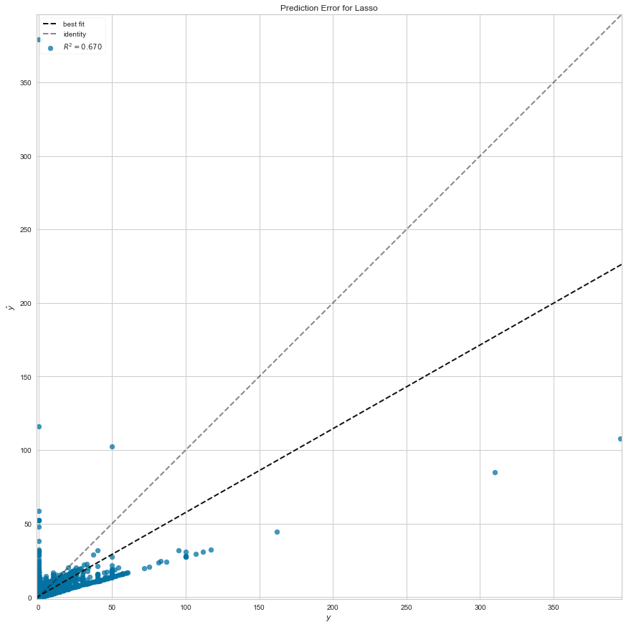
Linear regression with all the cost of the trip
Actual vs Predicted value table:
Prediction-error graph:
Row count | Actual | Predicted
0 | 2 | 1.999991
1 | 0 | 0.000004
2 | 9.2 | 9.199989
3 | 0 | 0.000007
4 | 0 | 0.000001
... | ... | ...
1512804 | 1.5 | 1.499998
1512805 | 0 | 0.000001
1512806 | 14.6 | 14.599965
1512807 | 2 | 1.999992
1512808 | 3 | 2.999989
1512809 rows × 2 columns

Slide 37
Looking at the predicted values for the linear regression with all the variables related to the cost of the trip, we see that the predictions are closely accurate. We can therefore come to a conclusion that the variables related to the cost of the trip are closely related to the target variable (tips). An increase in the cost variables will definitely have an increase in the target variable and vice versa.

Slide 38
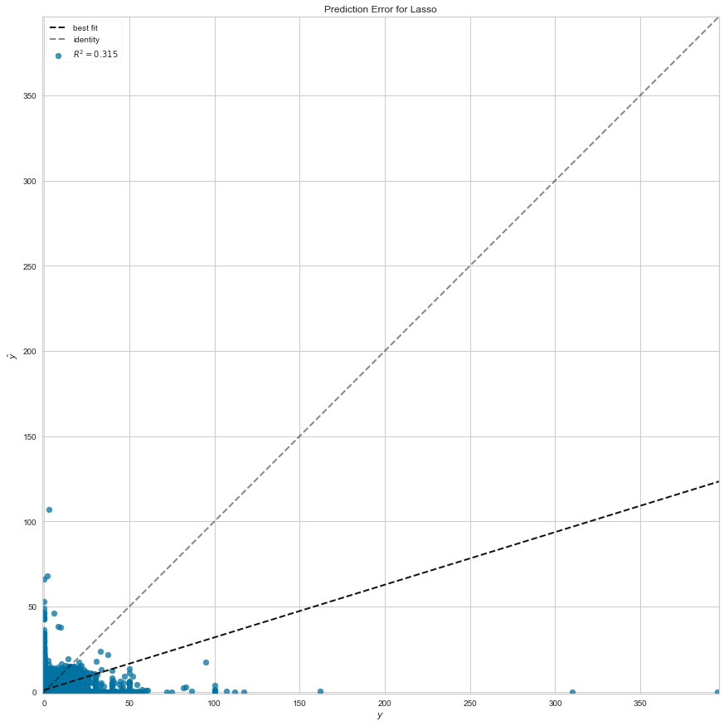
Linear regression with the distance and duration variables of the trip
Actual vs Predicted value table:
Prediction-error graph:
Row count | Actual | Predicted
0 | 2 | 0.512796
1 | 0 | 1.79846
2 | 9.2 | 5.413272
3 | 0 | 2.455773
4 | 0 | 0.801127
... | ... | ...
1512804 | 1.5 | 1.75427
1512805 | 0 | 0.993348
1512806 | 14.6 | 6.201426
1512807 | 2 | 0.897238
1512808 | 3 | 1.382866
1512809 rows × 2 columns

Slide 39
Seeing the predicted values for the linear regression with the variables related to the distance and duration of the trip, we can see that the predictions are moderate. We can hardly find a good prediction or a bad prediction in the list. Therefore, we can say that the duration and distance variables when taken separately do not play a vital role in predicting the target.

Slide 40
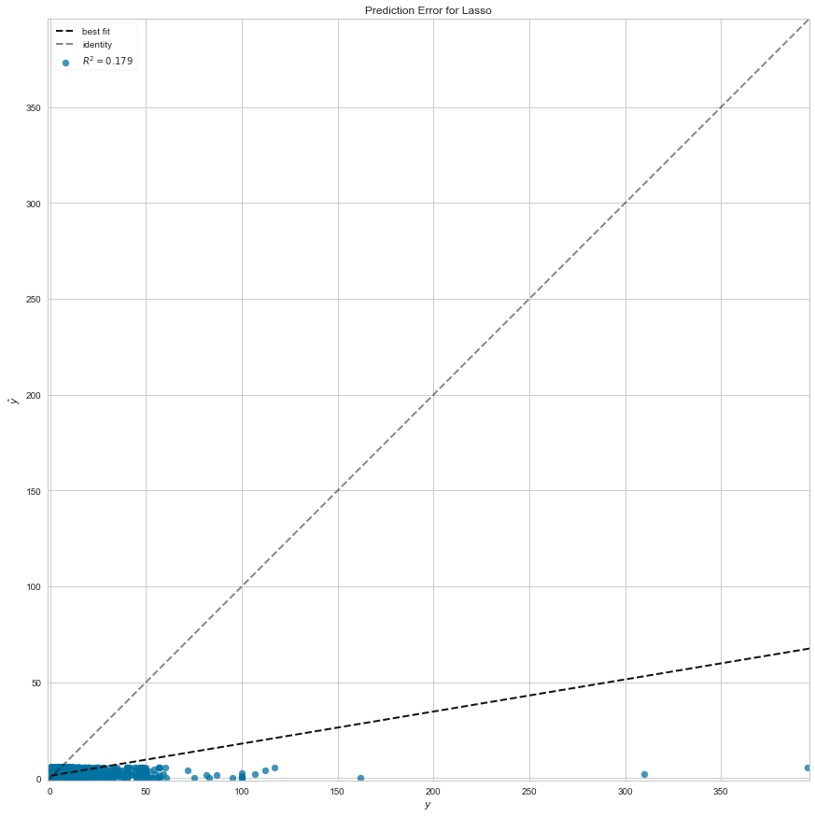
Linear regression with the variables related to community area
Actual vs Predicted value table:
Prediction-error graph:
Row count | Actual | Predicted
0 | 2 | 1.561498
1 | 0 | 1.030958
2 | 9.2 | 3.642602
3 | 0 | 1.530894
4 | 0 | 0.296451
... | ... | ...
1512804 | 1.5 | 0.786122
1512805 | 0 | 1.030958
1512806 | 14.6 | 2.377555
1512807 | 2 | 1.030958
1512808 | 3 | 0.90854
1512809 rows × 2 columns

Slide 41
By looking into the predicted values for the linear regression with the variables related to community area, we see that the predictions are not too good. We can hardly find a perfect prediction in the list. Hence we conclude that the variables related to community area do not make much change in the prediction for our target variable.

Slide 42

Linear regression with the variables related latitudes and longitudes
Actual vs Predicted value table:
Prediction-error graph:
Row count | Actual | Predicted
0 | 2 | 0.825822
1 | 0 | 0.886632
2 | 9.2 | 1.58686
3 | 0 | 1.816661
4 | 0 | 1.181276
... | ... | ...
1512804 | 1.5 | 1.281314
1512805 | 0 | 1.289858
1512806 | 14.6 | 1.880837
1512807 | 2 | 0.607813
1512808 | 3 | 1.192335
1512809 rows × 2 columns

Slide 43
Variables related to latitudes and longitudes have a negative correlation with the target variable. Checking the predicted values for the linear regression with the variables related to latitudes and longitudes, we can see that the predictions are not good. We can hardly find a good prediction in the list. Hence we can conclude that the variables related to community area are not directly proportional to the prediction for our target variable.

Slide 44
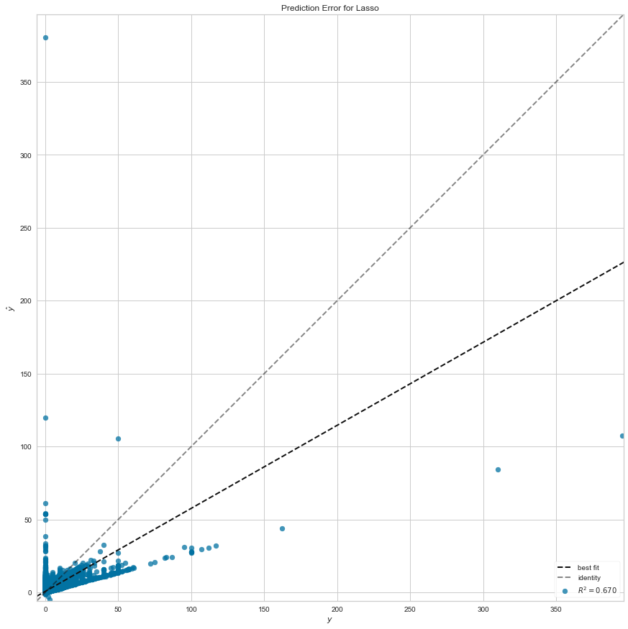
Linear regression with the positively correlated variables
Actual vs Predicted value table:
Prediction-error graph:
Row count | Actual | Predicted
0 | 2 | 1.997836
1 | 0 | 0.001962
2 | 9.2 | 9.190472
3 | 0 | 0.003075
4 | 0 | 0.001323
... | ... | ...
1512804 | 1.5 | 1.499923
1512805 | 0 | 0.001518
1512806 | 14.6 | 14.590097
1512807 | 2 | 1.998851
1512808 | 3 | 2.997788
1512809 rows × 2 columns

Slide 45
Looking at the predicted values for the linear regression with all the positively correlated variables, we see that the predictions are very closely accurate. We can hence come to a conclusion that the positively correlated variables are directly proportional to the target variable. They are very closely related to the target variable (tips). An increase in the cost variables will definitely have an increase in the target variable and in the same way, a decrease in these variables will also show a decrease in the target variable.

Slide 46
MODELLING AND PLOTTING THE GRAPHS
R-squared: R-squared is a statistical measure of how close the data are to the fitted regression line. It is also known as the coefficient of determination, or the coefficient of multiple determination for multiple regression.
Key Limitations of R-squared
R-squared cannot determine whether the coefficient estimates and predictions are biased.
R-squared does not indicate whether a regression model is adequate. You can have a low R-squared value for a good model, or a high R-squared value for a model that does not fit the data!
Are Low R-squared Values Inherently Bad?
No! There are two major reasons why it can be just fine to have low R-squared values.

Slide 47
The linear regression plots are made for all the following combinations of variables:
All the numerical variables
All the negatively correlated variables
Variables related to the cost of the trip
Distance and duration variables
Variables related to community area
Variables related to latitudes and longitudes
All positively correlated variables

Slide 48
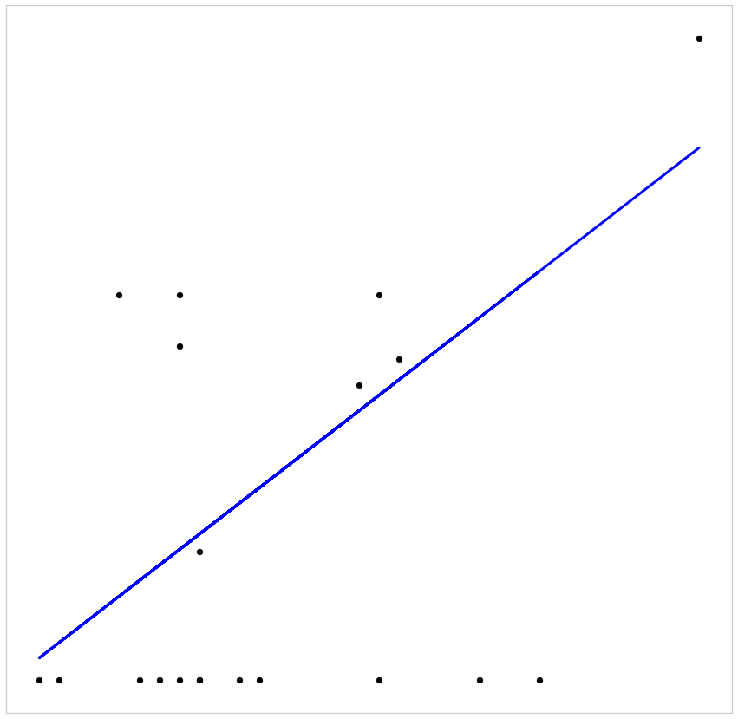
Linear Regression plot for the all the numerical variables
Coefficients: [[0.00200759]]
Mean squared error: 2.28
Coefficient of determination(R-squared): 0.01

Slide 49
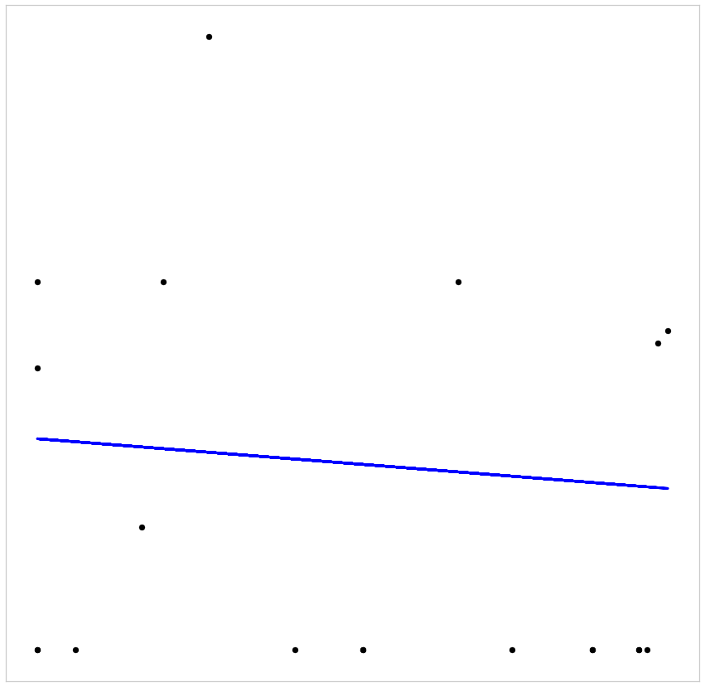
Linear Regression plot for all the negatively correlated variables
Coefficients: [[-0.00053288]]
Mean squared error: 2.40
Coefficient of determination(R-squared): -0.04

Slide 50
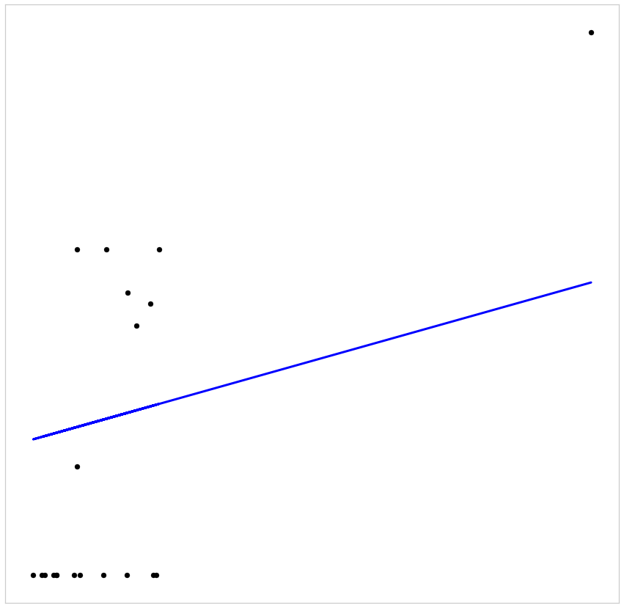
Linear Regression plot for the variables related to the cost of the trip
Coefficients: [[0.03025912]]
Mean squared error: 1.91
Coefficient of determination (R-squared): 0.17

Slide 51
Linear Regression plot for the distance and duration variables
Coefficients: [[0.00200759]]
Mean squared error: 2.28
Coefficient of determination (R-squared): 0.01

Slide 52
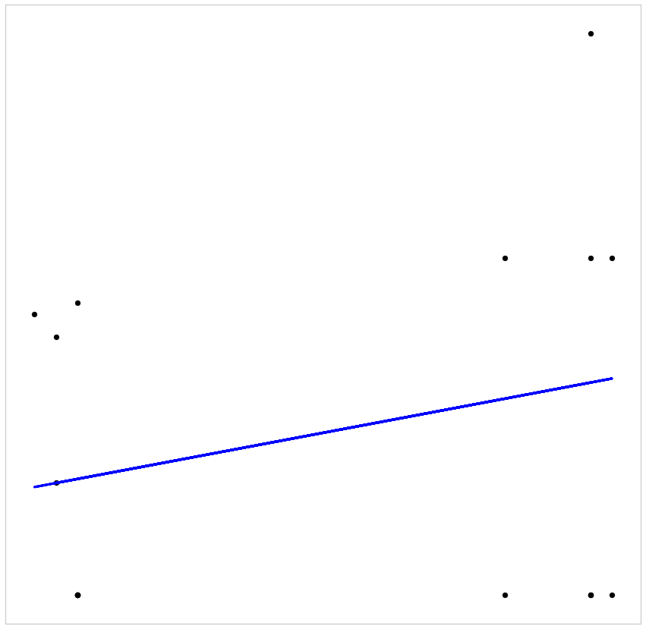
Linear Regression plot for the variables related to community area
Coefficients: [[0.03578704]]
Mean squared error: 2.25
Coefficient of determination (R-squared): 0.02

Slide 53
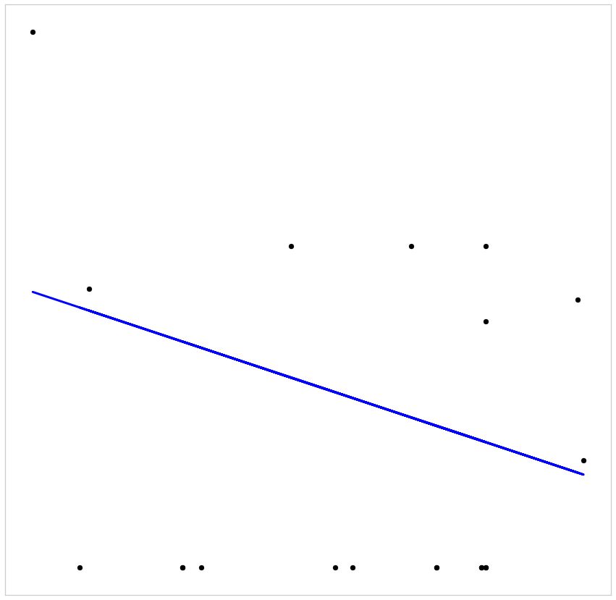
Linear Regression plot for the variables related to latitudes and longitudes
Coefficients: [[-0.0023203]]
Mean squared error: 2.52
Coefficient of determination (R-squared): -0.09

Slide 54
Linear Regression plot for the positively correlated variables
Coefficients: [[0.00200759]]
Mean squared error: 2.28
Coefficient of determination (R-squared): 0.01

Slide 55
Even though the calculated R-squared values are low, keeping in mind the limitations of R-squared, we can still conclude that the changes in the predictor values are associated with changes in the response value.

Slide 56
CONCLUSIONS
Based on these analysis, the possibilities of predicting the tips for a taxi ride depend mainly on the below mentioned factors:
Tips can be predicted using the below combinations:
-fare, extras and trip_total
-taxi_id, trip_seconds, trip_miles, pickup_community_area, dropoff_community_area, fare, extras, trip_total and company
While we have been able to improve the results, this may not be enough for the predictions as the customer reviews is not included. This is definitely a major factor in terms of considering whether to give a tip as it is a part of human behavior.

Slide 57
RECOMMENDATIONS
Including the customer reviews for further analysis will be helpful to get more precise predictions as it is directly related to providing tips.
To improve the accuracy in the prediction we can try using different algorithms as well

